Slide 1
Java Programming
CIS 175 Spring 2016
Jason Schalow
BE 310 6-10pm Tuesdays

Slide 2
Classes and Objects
Lecture 5

Slide 3
Classes in Java
Classes are used to:
Create a program
must have main method
may have other methods
may contain global data (eg: static Random)
Method library (eg: Math, RandomData)
contains useful static methods
may contain [static] data
Define new data type (eg: String, Card)
has instance data (fields)
has instance methods, including constructor(s)
may have class data &/or methods (static)

Slide 4
Method Library Classes
Are not used to create objects
Do not have main methods (usually)
Contain useful class methods [static]
May contain some class data [static]
Methods are called with the class name
This type of class is not very common in object oriented programming

Slide 5
Working with Objects
Suppose you wanted to run a poker tournament, on-line. What types of objects would you need to represent to handle multiple players, multiple tables, with betting?
Tournament: tables
Table: dealer, players, deck; play()
Dealer: deck, name (table assignment); deal()
Deck: cards; shuffle(), size(), dealCard()
Player: chips, hand, name; getCard(), bet(), buyChips()
Hand: cards, size; addCard()
Card: face, suit; value()
Chips: value, howmany()

Slide 6
Class Definitions
General form:
public class ClassName
{
// data member (variable) declarations
// constructor definitions
public ClassName(param list)
{
}
// method definitions
}

Slide 7
Constructors
Classes do not inherit constructors from parent classes
System supplied constructor takes no arguments
Does nothing but create the object (no initialization)
Once overridden, the class loses the use of the system supplied constructor
Can overload the constructor
Can access other defined constructors using this()
Can access parent's constructor using super()
only one level of indirection allowed (no super.super() allowed )

Slide 8
Constructors
public class ConstructorDemo extends Worker{
public static void main( String args[] ) {
ConstructorDemo a = new ConstructorDemo();
ConstructorDemo b = new ConstructorDemo("Label");
ConstructorDemo c = new ConstructorDemo(42);
ConstructorDemo d = new ConstructorDemo(36,"Full");
System.out.println(a.amount + " " + a.label);
System.out.println(b.amount + " " + b.label);
System.out.println(c.amount + " " + c.label);
}
private int amount;

Slide 9
Constructors
ConstructorDemo(){ // constructor with no args
this(0, "empty");
}
ConstructorDemo(String s){ // four overloaded constructor methods
this(0, s );
}
ConstructorDemo(int i){
this(i, "empty");
}
ConstructorDemo( int i, String s ){
super( s );
amount = i;
}
}

Slide 10
Constructors
class Worker{
String label; // default protection, so that
// theConstructors class inherits it
Worker( String str ){ // a single constructor method with an arg
label = str;
}
}

Slide 11
Class Member Types
Instance
data – variables that each individual class object will contain its own copy of and values for
method – is called with a class object and may operate directly on the instance data members
Static (also called "class" members)
data – variables that are shared by all objects in the class; there is only one copy
method – stand-alone method that does not need any instance members (data or methods) to do its job; called with the class name

Slide 12
Access Specifiers
public
can be directly accessed from any other class
used for classes, constructors, and many methods
protected
can be directly accessed from any other class in the same package (file folder)
used for inheritance related classes usually
private
can only be directly accessed from within the same class
used to protect data
used for helper methods

Slide 13
Java Access Modifiers - Accessible ?
Modifier | Everywhere in program | In a Subclass | In rest of Package | In rest of Class
public | Yes | Yes | Yes | Yes
protected | No | Yes | Yes | Yes
Default case (no keyword) | No | No | Yes | Yes
private | No | No | No | Yes

Slide 14
Other Modifiers effect on variables, methods & classes
Modifier | Variable | Method | Class
static | Belongs to class | Class method | Promotes to outer class
final | constant | Cannot be overridden | Cannot be subclassed
void | N/A | No return type | N/A
native | N/A | Implemented in non Java | Contains a native method

Slide 15
Objects are references
a variable of a class type is a reference to the actual object
the reference variable holds the memory location of the actual object
the object holds the actual data
Card c = new Card(6, "Hearts");
face
suit
6
Hearts

Slide 16
Abstract Classes
Cannot be instantiated
Used to embody a design and partial code

Slide 17
Abstract Classes
abstract class Design{
public abstract void start( int x );
public abstract void stop( int y );
protected int state = 0;
public String description(){
return "This conforms to the Design designation: " + state;
}
}

Slide 18
Abstract Classes
public class Abstraction extends Design{
public static void main(String args[] ){
Abstraction a = new Abstraction();
a.start(1);
a.stop(2);
System.out.println(a.description());
}
public void start(int x){ // must provide start and stop
state = x; // or Abstraction will also be abstract
}
public void stop(int z){
state += z;
}
}

Slide 19
Interfaces
Like abstract classes but no bodies or variables
Used for interface spec–equivalent to a C header file
Classes can implement as may interfaces as desired
Compiler will flag non compliance with interface spec

Slide 20
Interfaces
interface Template{
public void start( int x );// these abstract methods must have no body
public void stop( int y ); // no member variables allowed in interface
}
interface Template2{
public String description();
}

Slide 21
Interfaces
public class Interfacial implements Template, Template2{
private int state = 0;
public void start(int x){ // must have start, stop & description
state = x; // or compiler will error
}
public void stop(int z){
state += z;
}
public String description(){ return "I conform"; }
}

Slide 22
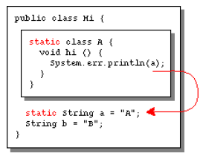
Inner Classes
Starting with Java version 1.1, classes can be nested:
Hi is an outer class
Hi.A is a nested top-level class and could be an interface
A has the same access to things as other classes in a package
A can reach all static things in Hi.

Slide 23
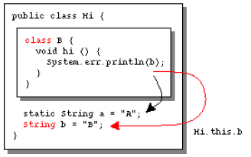
Inner Classes
Hi.B is a member class and cannot be an interface or contain static methods.
An instance of B can access all members of that instance of Hi which created it
An instance of B cannot be created in a class method of Hi
If necessary, the prefix Hi.this can be used to access a member of Hi from B.

Slide 24
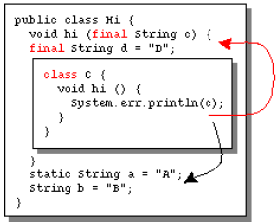
Inner Classes
Hi.C is a local class and cannot be an interface
Methods of Hi.C can access all final local variables and parameters of it's surrounding method or block and additionally all members (or static members, depending on context) of Hi

Slide 25
Object class in JAVA
Base of all other classes
Contains these methods:
String toString()
returns class name + memory address
boolean equals(Object o)
compares memory addresses (same as ==)
Object clone()
returns copy of object
We override these methods (toString & equals especially) in our classes to get more appropriate behaviors than the default provided

Slide 26
Object Oriented Design
OO Design ideas
OO Design Tools & Methodologies

Slide 27
OO Paradigm Characteristics
Encapsulation - data + methods
Information Hiding - public/private etc
Message Passing - client uses class’s interface
Late Binding- specific receiver not known until runtime
Delegation - passed up the class hierarchy
Class & Objects - instantiation
Inheritance & polymorphism - subclasses & overriding
Relationships - association & aggregation
OO provides powerful tools for building large systems… How do we apply them?

Slide 28
The Declare-Define-Use Approach (DDU)
DDU is a repetitive design-implement-test-maintain cycle
Specifications
Identify all classes
For each identified class do
Declare it
Test it
Integrate it
Write main

Slide 29
DDU Example (simple)
Simulation of an automatic elevator
SPECIFICATIONS:
a) Input: number of riders randomly placed at random floors; floor numbers entered by keyboard
b) Output: Which floor elevator is on; direction it is heading; when riders enter and leave elevator
c) Constraints: riders may call from any floor and exit any floor; elevator is idle until called; operates until all requests completed; must board elevator when requested and and must disembark when floor is reached; no limit on number of passengers

Slide 30
Choose a Class Elevator DECLARE THE CLASS ELEVATOR
Public:
Elevator
ButtonsPushed
MoveToNextFloor
DisplayStatus
floorButtons[size ]
int currentFloor
Going
Private:
ChooseMove
Create and initialize elevator
Are any floor buttons pushed?
Moves the elevator
Tell where the elevator is
One button per floor (ON / OFF)
Number of floor elevator is on
Direction indicator (UP / DOWN)
Determine floor to move to

Slide 31
RULES OF THUMB for designing classes:
The nouns from the program specifications are usually implemented as classes while verbs are the functions.
When in doubt, refer to reality.
Don't be afraid to redesign your classes.
Declare member data as private and member functions as public. You can always revise your declarations later.

Slide 32
Design methodology…
To declare a class, we write its Java file (.java)
To use a class, we write a driver program that tests the class as completely as possible
The time we spend testing classes individually will more than pay for itself when it comes to testing our complete program
To integrate a class, we write a driver program that exercises the class in the context of other classes that refer to it

Slide 33
Some Tools of OO Design
CASE (Computer assisted software engineering) has incorporated several OOD notations.
CRC (Class-Responsibility-Collaborator) note-card system is a low-tech scheme, easy to use and flexible.
The UML (Unified Modeling Language) is the most used.

Slide 34
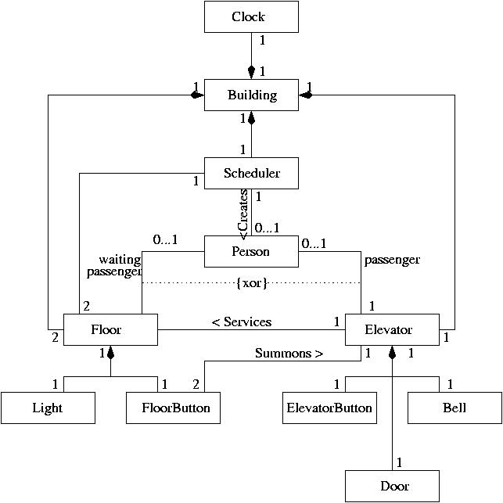
UML Diagram for Elevator
UML diagram showing:
Classes
Relationships
Ordinals

Slide 35
Class-Responsibility-Collaboration (CRC)
The responsibilities are what the object must be able to do and what the object must know (attributes and behaviors of the class).
A collaborator is another object that interacts with the given object.
Person presses button on a given floor.
An object of the Person class sends a message to an object of the button class.
Collaboration between the class Person and the class Button

Slide 36
CRC cards rewritten & refined during design process
Front of card:
(public behaviour)
Classname: Person
Responsibility:
ID, exitElevator, enterElevator,...
Collaborators:
person sends pushButton message to the
FloorButton object, ...
Back of card:
(implementation details)
ID : int
exitElevator( ) : void
enterElevator( ) : void

Slide 37
The Game of Life Refactored
Lab 2

Slide 38
Lab 2 Description
In this lab assignment, you will be refactoring your previous GameOfLife application to implement the Model-View-Controller pattern and a Strategy pattern
Like the last lab, the completed lab will consist of an electronic copy of the Java code file you develop
This lab will be graded based on the following factors:
Commenting: Are all classes, methods and variable declarations (both properties and private variables) documented with inline comments
Functionality: does the submitted code compile and run? Does it meet the requirements given below?

Slide 39
Game Of Life Design
Model
Controller
Strategy
GameOfLife
GoLBoard
Interface
Class
Class
<Uses>
GoLInitializer
<Uses>
<Uses>
<Implements>
<Uses>
<Uses>
Class
Class
GoLCell
GoLRandomInitializer
View
<Uses>
Class
<Uses>
GoLDisplay
<Uses>
Class
GoLNeigborhood

Slide 40
Class Descriptions
Class GameOfLife
This is the executable controller class for the Game of Life simulation. It should initialize other objects and control stepping through the rounds, calling the appropriate methods in both the GoLBoard class and the GoLDisplay class. It should not contain any code related to updating cells, etc.
Method | Returns | Description
main | void | Entry point for the program

Slide 41
Class Descriptions
Class GoLBoard
This class implements a model for the game board.
Method | Returns | Description
constructor () | n/a | Calls the overloaded constructor below with the default GoLRandomInitializer
constructor (GoLInitializer myInitializer) | n/a | Created a new GoLBoard initialized by the provided initializer
nextRound() | GoLBoard | Updates the board for the next round by calling the updateCell method of the individual cells, passing a GoLNeighborhood to them. Returns the updated board.

Slide 42
Class Descriptions
Method | Returns | Description
getCell(int x, int y) | GoLCell | Returns the cell at the specified coordinates
copyBoard() | GoLBoard | Returns a copy of the current board
reset() | GoLBoard | Re-initializes the board
reset(GoLInitializer myInitializer) | GoLBoard | Re-initializes the board with the provided GoLInitializer
getCurrentRound() | int | Returns number of the current round
getBirths() | int | Gets number of births from last round
getDeaths() | int | Gets number of deaths from last round

Slide 43
Class Descriptions
Class GoLCell
This class implements a model for an individual cell.
Method | Returns | Description
constructor (boolean) | n/a | Creates a new cell that is alive if the parameter is true or false otherwise
updateCell(GoLNeighborhood myNeighborhood) | boolean | Updates the cell using the given neighborhood and returns true if alive and false if dead
isAlive() | boolean | returns true if alive and false if dead

Slide 44
Class Descriptions
Class GoLNeigborhood
This class implements a model for the neighborhood of an individual cell.
Method | Returns | Description
constructor (GoLCell[][] cellNeighbors) | n/a | Creates a new neighborhood using the 3x3 array provided
getCell(int x, int y) | GoLCell | Gets the cell at coordinates x,y in the neighborhood

Slide 45
Class Descriptions
Interface GoLInitializer
This class implements an interface for initializing a board.
Method | Returns | Description
getCellArray() | GoLCell[][] | Returns an array of cells

Slide 46
Class Descriptions
Class GoLRandomInitializer
This class implements an interface for initializing a board.
Method | Returns | Description
constructor () | n/a | Creates new GoLRandomInitializer with a random seed
constructor (long seed) | n/a | Creates new GoLRandomInitializer with a given seed
getCellArray() | GoLCell[][] | Returns an array of cells

Slide 47
Class Descriptions
Class GoLDisplay
This class implements a model for the neighborhood of an individual cell.
Method | Returns | Description
constructor () | n/a | Creates a new display object
displayBoard(GoLBoard gameBoard) | void | Outputs the current board along with round number, births and deaths

Slide 48
For Next Time
Read the information on inheritance on the Oracle Java Tutorial site:
http://docs.oracle.com/javase/tutorial/java/IandI/subclasses.html
Review the information on interfaces:
http://docs.oracle.com/javase/tutorial/java/IandI/createinterface.html

